Slide 1

Location Tracking shoe for kids

Slide 2
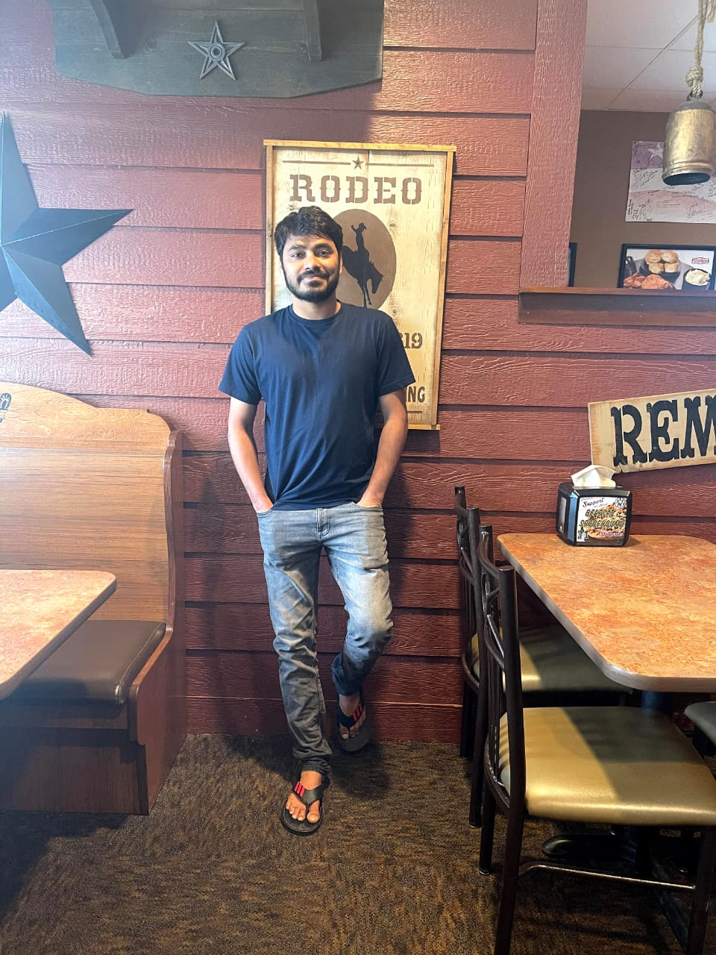



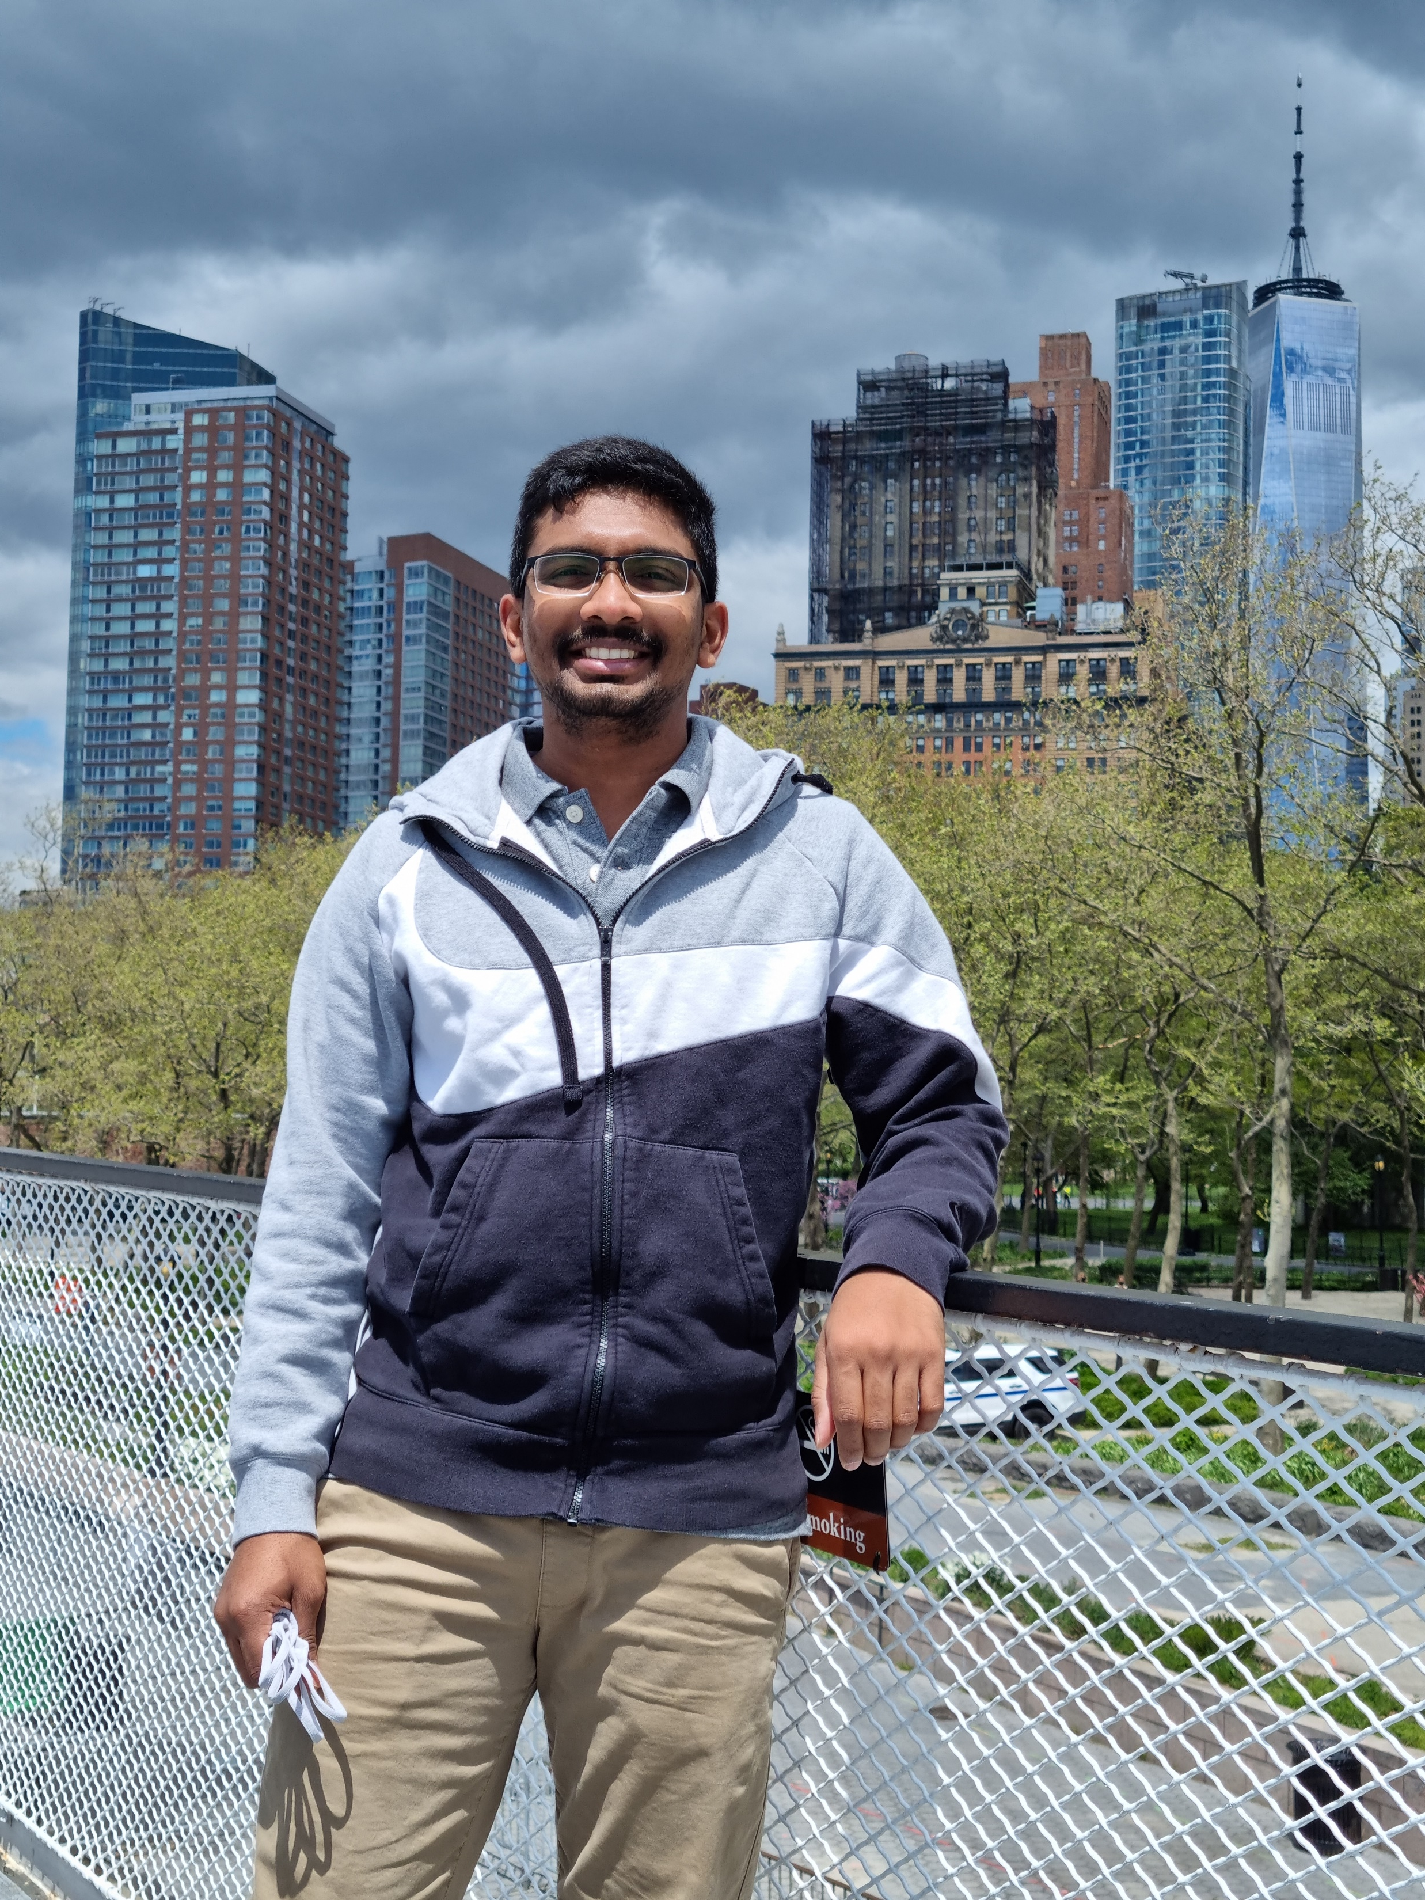
Team members Group 6 - Tracecatchers
Nagarushyanth Tummala
Project Lead
Application Developer
Amulya Mallepalli
Software Developer
Ajay Kumar Reddy Arram
Test Engineer
Jr. Developer
MadhuBabu Konda
UI/UX Developer
Jeevan Bodigam
Project Manager

Slide 3
Introduction
This project is basically a shoe meant for kids, with a GPS tracker installed in the sole. The shoe would be wirelessly connected to the parent’s mobile application developed by our team through which they would be knowing the child’s live location.
The proposed project provides customers a hassle-free location tracking services which could track real time location for children who are vulnerable of missing, kidnapping or being a victim of child trafficking. The project must comprise of balances reasonable cost, effort, timely delivery, quality, and functionality.

Slide 4
Problem statement
TraceCatchers software Development Company whose main business focus is to develop shoes with GPS tracker, web applications and mobile applications for finance and business sectors.
Upon a client’s requirement, TraceCatchers wants to build an application that helps keep track of the kid's location using GPS tracker.
A project management team at TraceCatchers is assigned the responsibility of building the list of documents required for building the application.

Slide 5
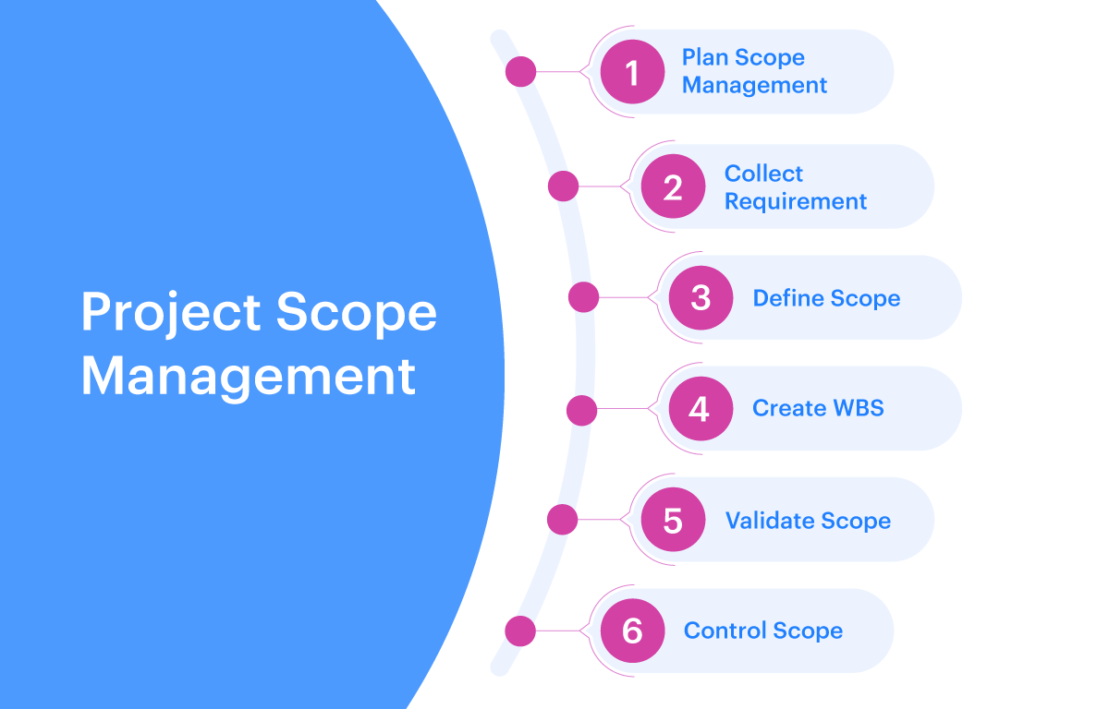
Project scope management
Coming to our project scope we keep track of kid's location by using GPS tracker.
This will help their parents to track their location to prevent any danger or harm.

Slide 6
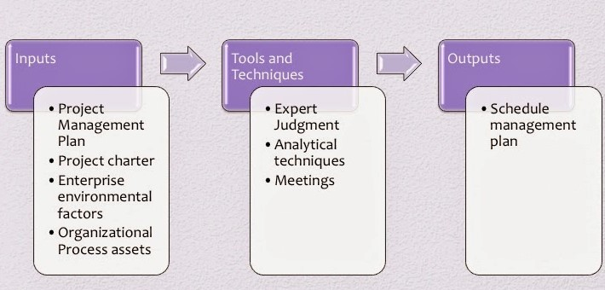
Project schedule management
Defining Activities
Activity Sequencing​
Estimating activity resources
Activity duration estimating​
Schedule development​
Schedule control

Slide 7
Project communication management
Communication management focused on how important information will be communicated to stakeholders throughout the project. We identified our project’s communication needs and chose methods which best suited us.
Methods:
Email
Daily standup meetings.
Google tools.

Slide 8

Project cost Management
Project Cost Management is a method that uses technology to measure cost and productivity through the full life-cycle of enterprise level projects.
Project success hinges on cost management, as cost is the primary determining factor for the success or failure of the venture overall.
 | Direct Cost | Indirect Cost | Recurring Cost | Non-Recurring Cost
Project Manager cost
GPS Cost
Shoe Material cost
Application Development cost
Labor cost
Survey cost

Slide 9
Project resource management
Project Resource management uses the physical and human resources involved in a project effectively
It involves gathering internal as well as external resources that are needed to deliver a project and deploying them.

Slide 10
Project quality management
Project quality management is all of the processes and activities needed to determine and achieve project quality, where quality means meeting the needs of customers.
The below three steps are involved in quality management plan.​
Quality Planning – This process is done during the planning phase.​
Quality Assurance – This process is done during the execution phase.​
Quality Control – This process is done during the control phase​
Few of the quality focused areas in our project
Training the worker to assemble different parts
Quality of the material used to make the shoe vamp
Overall design & comfort
App and trackers synchronization
Sufficient power and quality cells for the GPS chip
Testing the shoe’s response to water, dirt, etc

Slide 11
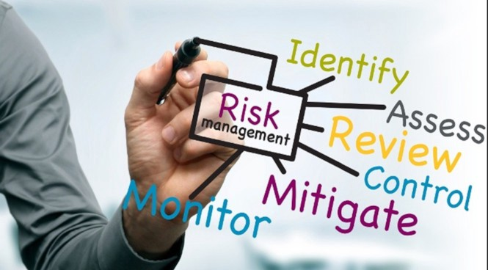
Project risk management
Project risk management is about identifying, analyzing, and responding to risk.​
Risk Identification​
Quantitative Risk Analysis​
Qualitative Risk Analysis​
Risk Monitoring and Control

Slide 12
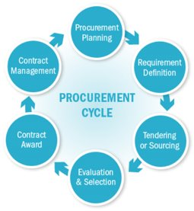
Project procurement management
Project Procurement Management means acquiring goods and services for a project from outside the performing organization.​
Planning procurement management​
Conducting procurements​
Controlling procurements

Slide 13
Project Stakeholder management
Project stakeholder management processes​
Identifying stakeholders​
Planning stakeholder management​
Managing stakeholder engagement ​
Monitoring stakeholder engagement​

Slide 14
Conclusion
We would like to conclude that by following all the processes given in all the knowledge areas the overall lifecycle of the project went smooth by reaching all the application standards.

Slide 15
Thank you

